Slide 1


CIMCYC Workshop Computational modelling of behavioral data
2nd June 2022
Funded by:

Slide 2





Schedule
09:30
Introduction to computational models on decision making
10:00
Distributional analyses and Drift Diffusion Model (DDM)
11:30
Hands-on session on DDM
----- LUNCH ------
15:00
Introduction to computational models on reinforcement learning (RL)
15:30
RL theory
17:00
Hands on session on RL
Carlos
Luc
Javier
Francesco
All slides and materials are availabe at: https://github.com/ortiztud/cmb

Slide 3
What is (cognitive) modelling?
Making a simple, formal representation of a theory (here, about cognitive processes)
First intuitive theory, then made more precise (into a model), then empirical test
“In cognitive neuroscience, modeling is a tool to help construct better theories of cognition and behavior”
(Verguts, 2022)
Models allow for making novel predictions that don’t obviously follow from the theory
Models allow integration of existing data in a well-organized conceptual framework

Slide 4
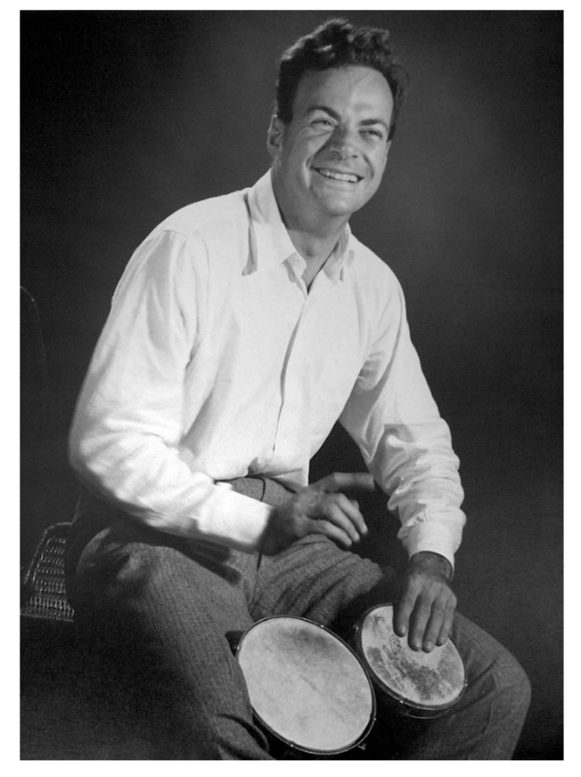
Why (cognitive) modelling?
“What I cannot create, I do not understand”.
—Richard Feynman

Slide 5
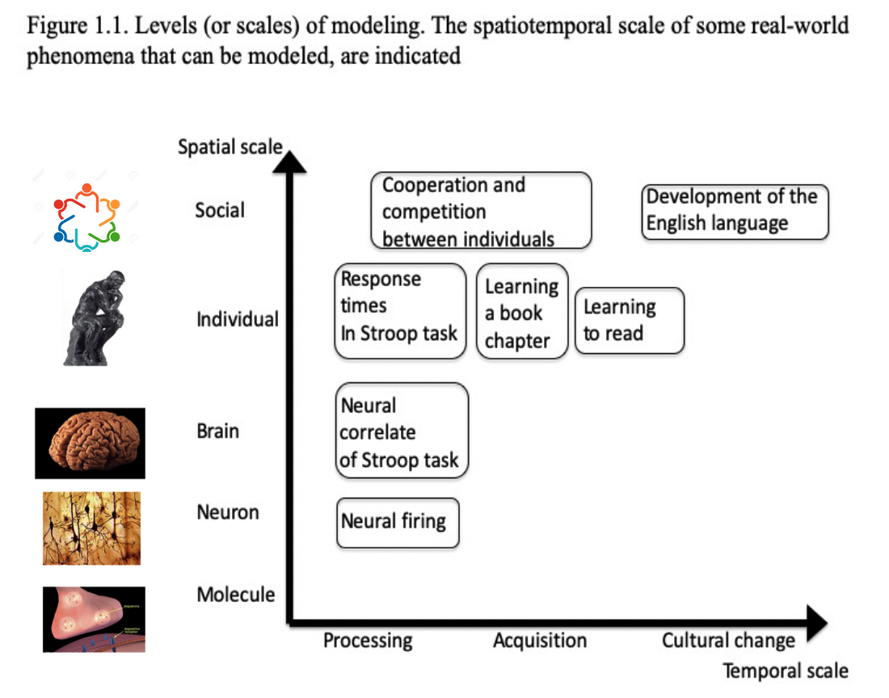
Levels of modelling

Slide 6
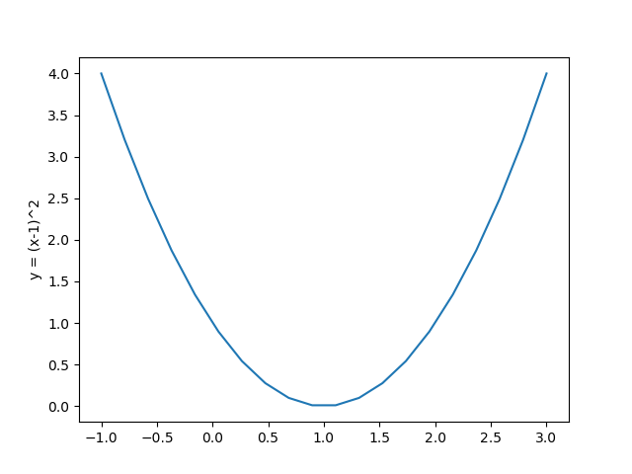
The opimization principle
Basic principle: Humans (or other organisms) are always busy attempting to reach a goal
In a model, “Attempting to reach a goal” can be captured with the standard mathematical principle of optimization
Models attempt to ”reach a goal”, which can be formalized in optimizing a mathematical function
Assumption that behavioral and neural dynamics are consequences of attempting to reach that goal
Finding the optimal point of a function

Slide 7
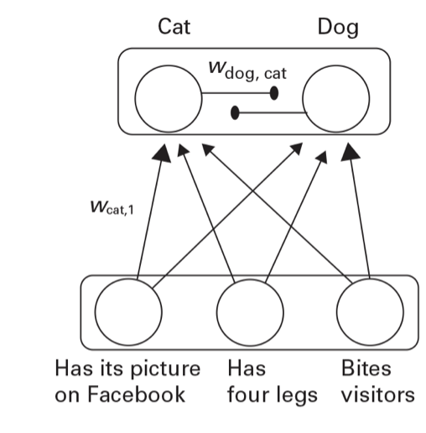
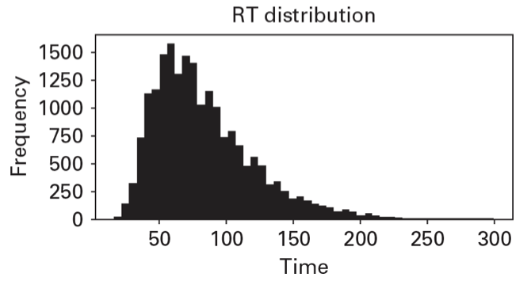
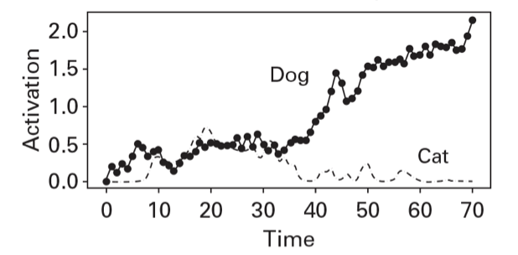
Modelling decision making
Decision making can apply to any situation where an agent must choose between two or more actions
“Is this a cat or a dog?”
Trajectories of Cat and Dog detectors in trial t
Notes:
Let’s imagine we want to créate a model that differentiates cats from dogs, for instance, for a machine that must learnt to dispense cat food or dog food.
This machine has Feature detectors (for the sake of the argument let’s imagine these are high-level feature detectors).
Feature detectors could be binary (either ON or OFF), or they could take some activation value in the range 0 to 1, in which activation = probability of the detector considers the feature is present.
What does a value of x = 0.8 for the bites visitors feature mean?
This machine also has a CAT DETECTOR and a DOG DETECTOR, which receive the activation of the first three detectors as input. As output, we get an activation level x for each of the detectors. Keep in mind cat and dog detector inhibit each other.
What do we do with this activations? An organism (or a model) does not use one single piece of evidence (activation) to make a decisión, but rather simples the activation space multiple times to achieve an optimal decisión. Within this framework:
RT = the number of steps needed to find this optimal point
Final decisión (sometimes, accuracy) = state in which the model ends when it finds the optimal point.
In this way, one can model choice and RT data simultaneously. This is exactly the rationale nehind sequential sampling models, among which we can find the DDM.

Slide 8
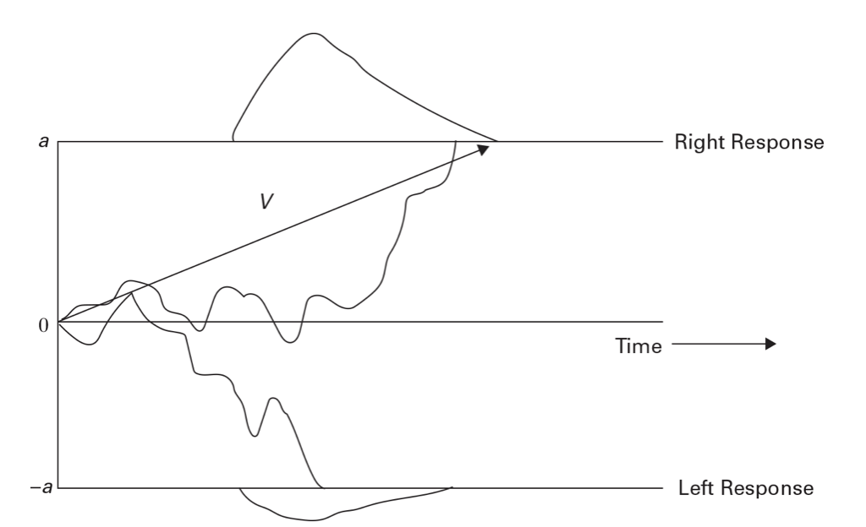
Modelling decision making – the Drift Diffusion Model
Popularized in Psychology by Ratcliff (1978)
In the DDM, a key aspect is the difference between the activations of the different (e.g. cat / dog) detectors
When the difference reaches a threshold, the model decides that the stimulus is a dog / cat
Trajectories of Cat and Dog detectors in trial t

Slide 9
DDM main parameters
DDM models decision making as a noisy accumulation of evidence
Main parameters:
Drift rate (v): average slope of the decision trajectory, that is, speed of information uptake
Threshold separation (a): amount of information considered for a decision
Starting point (z): point where the accumulation process starts. Reflects bias towards one of the thresholds
Nondecision time (t): it captures all processes not related to the decission process. Reflected in rightward shifts in the RT distribution

Slide 10
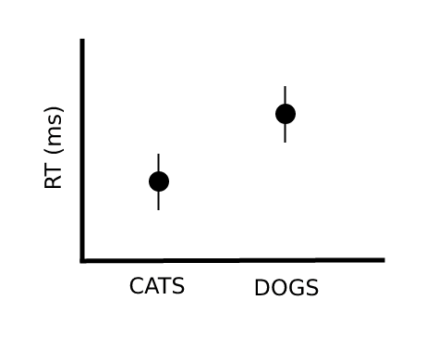
DDM in Psychology
Very popular in Psychology because it allows to fit RT and ACC simultaneously (i.e. common behavioral metric)
﻿Different cognitive processes are mapped to different psychologically meaningful parameters.
Moreover, these parameter estimates are less noisy than RT or ACC alone, which improves reliability and effect sizes
The promise is to gain information not only about whether participants are slower (or less accurate), but also why:
Slowdown of information uptake
Delayed motoric response execution
Bias towards one of the thresholds
Correct
Correct
Correct
v(cats)
v(dogs)
z(cats)
t(dog)
z(dogs)
t(cat)
Incorrect
Incorrect
Incorrect

Slide 11
DDM in Psychology
DDM disentangles a number of intuitively appealing concepts:
Changes in drift rate can express:
Stimulus quality
Participant ability
Decision difficulty
Changes in threshold can express:
Cautiousness
Speed-accuracy trade-off (higher threshold entail slower but more accurate responses)
Changes in starting point can express preference of a response threshold:
Reward
Priming
Proportion effects
Changes in nondecision time can express:
Differences in basic encoding processes
Configuration of WM for a task
Differences in motoric processes related to response execution

Slide 12
DDM in Psychology
Model(s) creation and optimization
Model-based simulations
Model fit assessment
Model comparison

Slide 13
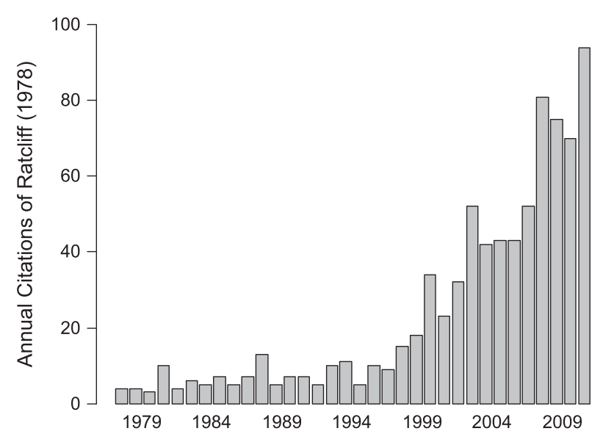
Applications of the DDM
“Basic” cognitive neuroscience
Decision making
Cognitive control
Working memory
Attention
ADHD
Aging
Psychiatric disorders
Dyslexia
Development
Sleep deprivation
…

